Slide 1
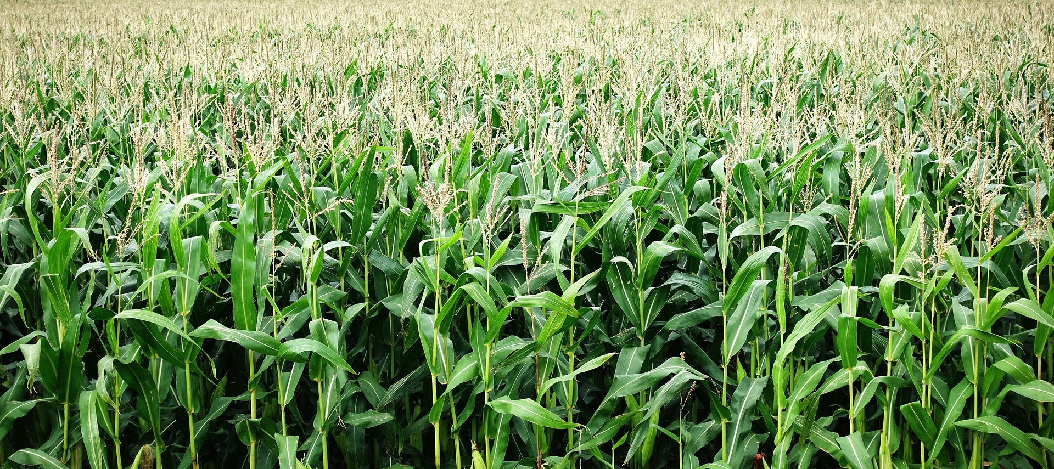

Shintsha
A Decentralized Online Market: Connecting Remote Organic Farmers with Buyers Via Whatsapp & Web3!!
Road2DevCon Hackathon
Consensys Labs Relay Bounty:
Open Finance | Decentralizing Research

Slide 2
Preview
The agricultural business has revolutionized in recent years but still faces multiple challenges. The supply chain has been faced with the non-transparent, inefficient and noncommunicating network made up of processes, data, actors, and products. Disconnection and lack of transparency complicate issues of fair pricing and quality of products.
The need for data integration has resulted from the regulatory pressure, scandals and food crises. Transfer of funds to business partners in other countries without delay or worry of fraudsters. Blockchain will play an important role in supply chain intelligence for technology that facilitates easy traceability of product information. We aim to provide direct access to enable remote farmers reach their investors without the assistance of middle-men, Whatsapp was chosen since it requires a minimum onboarding process for the user. Remote organic farmers can directly interact with customers via WhatsApp, take orders, investors can make payment and farmers can advertise their products to investors, all these information is stored via smart contracts in the blockchain, enabling transparency, trust and fostering an open transaction economy .

Slide 3
Limitation faced by farmers in Africa
The agricultural sector in Africa remains the main source of livelihood for a large proportion of the continent’s population and a significant contributor to the GDP. In Africa, agriculture and the innovation around agriculture fundamentally continue to be a catalyst of sustainable development primarily for enhanced food security, secondary, in the reduction of poverty and the overall growth of the continent’s economy. The sector grapples with a myriad of problems. The agriculture ecosystem in Africa is broken at all levels right from the crop and livestock production level to the last mile of reaching consumers. The challenges can thus be classified as follows;
Primary production- Farmers hardly receive quality fertilizer and seeds, lowering productivity to 10% of the global average for almost every crop.
Pricing information & access to markets- Farmers do not have access to current information on market prices or even access to the trading markets thus demand & supply can’t be matched. This also creates a loophole for middle-men who control the market conditions.
Access to financial services- Most farmers in Africa practice small-scale farming and a majority do not have access to bank accounts. Most are therefore undocumented with any financial services thus making their creditworthiness hard to determine. Due to this, many have no access to credit which they require to scale their farming.

Slide 4
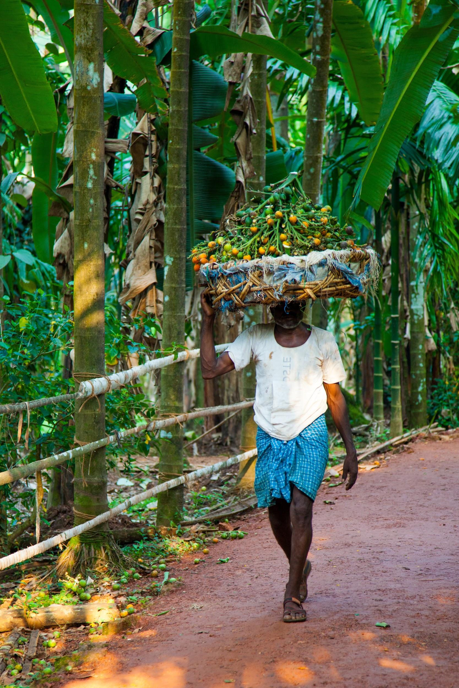
Meet Obi
This is a fictional Obi - he’s an organic farmer from Senegal
He needs direct access to consumers to advertise his produce and take orders for the next planting season, he prefers this so he isn’t extorted by big market players (middlemen).
How can this be possible when he has access to little internet and uses a whatsapp enabled mobile phone? How would he advertise his products? How would consumers view his products? How could he deliver to them? and how secure and transparent would it be?.

Slide 5

Meet Stan
This is a fictional Stan, he is a consumer of organically produced food, and works 9-5.
He’s low on free time and needs a way to order organic natural food online, if possible via a messaging app..
He also needs a delivery service to bring these to his office and would appreciate if he could access the farmer of these goods easily not with the assistance of middlemen.
He’s also concerned about the security of the food, and would be thrilled to know if the farm is verified and if he could monitor the ordered products till delivery is made.

Slide 6
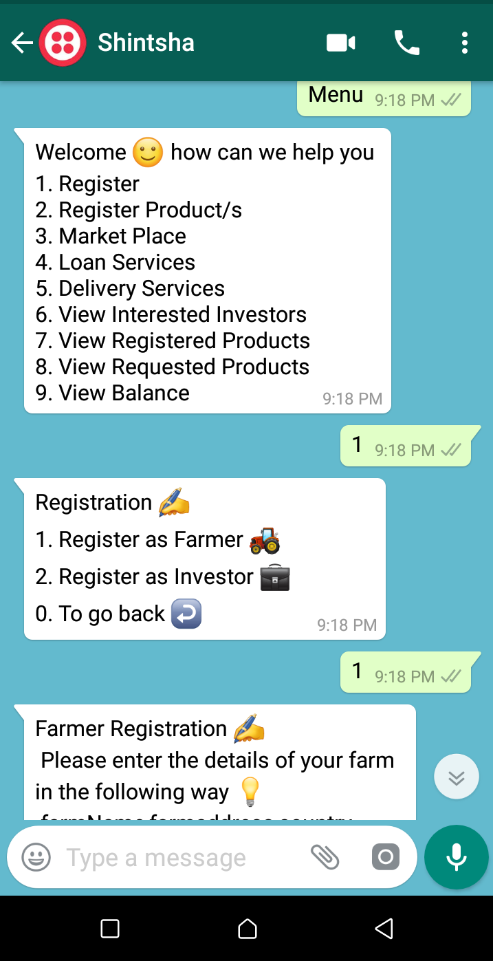
The Solution: Shintsha
Use case: Farmers can register on the Shintsha whatsapp platform using their whatsapp enabled phones, farmers can also register products, view products, be notified when a buyer is interested in their product, etc.
Potential partners / clients:
Millionaire Farms
AGROGEN
Buyers
Solution: A decentralized web3 UI and Whatsapp=enabled connection for remote organic farmers to interact with buyers, they can receive orders from local and international investors and also gain access to soft loans. We chose whatsapp because of it’s high level for the user and it’s encrypted and secured.
Benefits:
Reduce middlemen interference in Agriculture in Africa
Create valuable exchange between both parties (Matching demand and supply).
Promote organic farming and CSA in Africa
Enable access to loans for SMEs and farmers through a trust rated(Kudos & NFTs) system built overtime on Shintsha.

Slide 7




User Journey
Farmer & Investor adds Shintsha no - +1 415 523 8886 as a contact on his mobile
Send a prompt - “join using-carried” to be added to the sandbox.
Type Menu and click enter to view a list of options
Type 1 and send to register as a farmer or type 2 and send to register as an investor

Slide 8
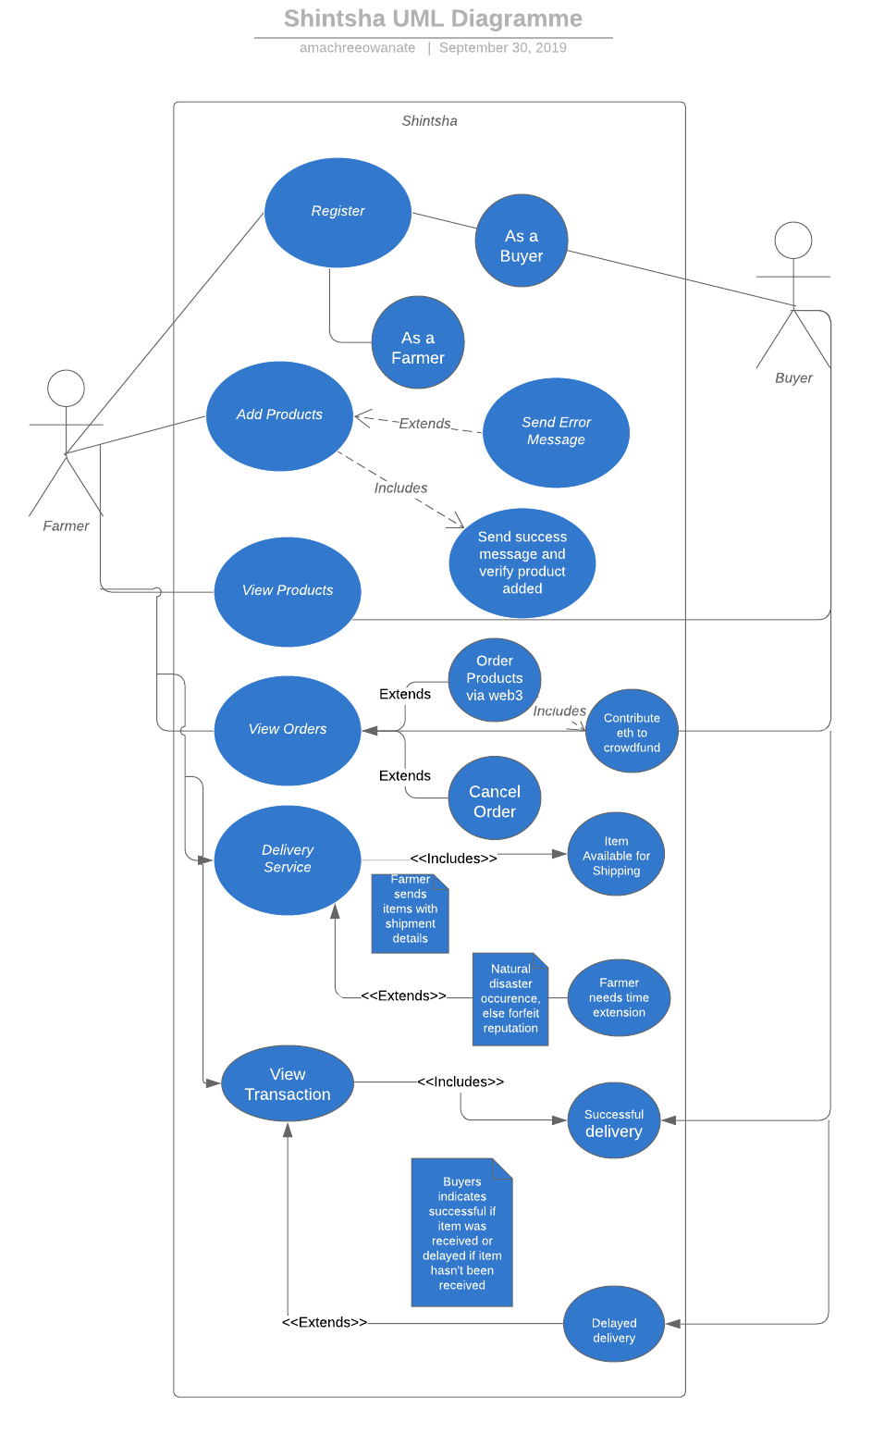
UML Use Case

Slide 9
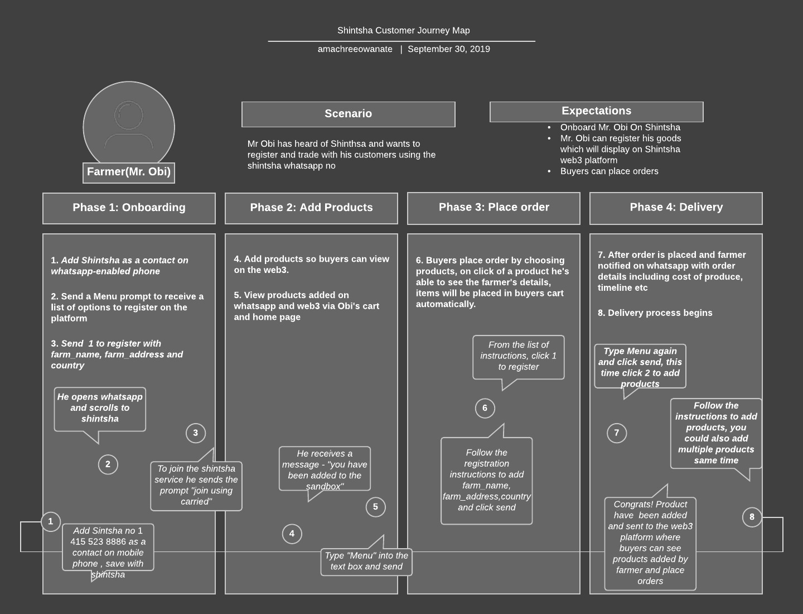

Slide 10
How SHINTSHA works

Slide 11
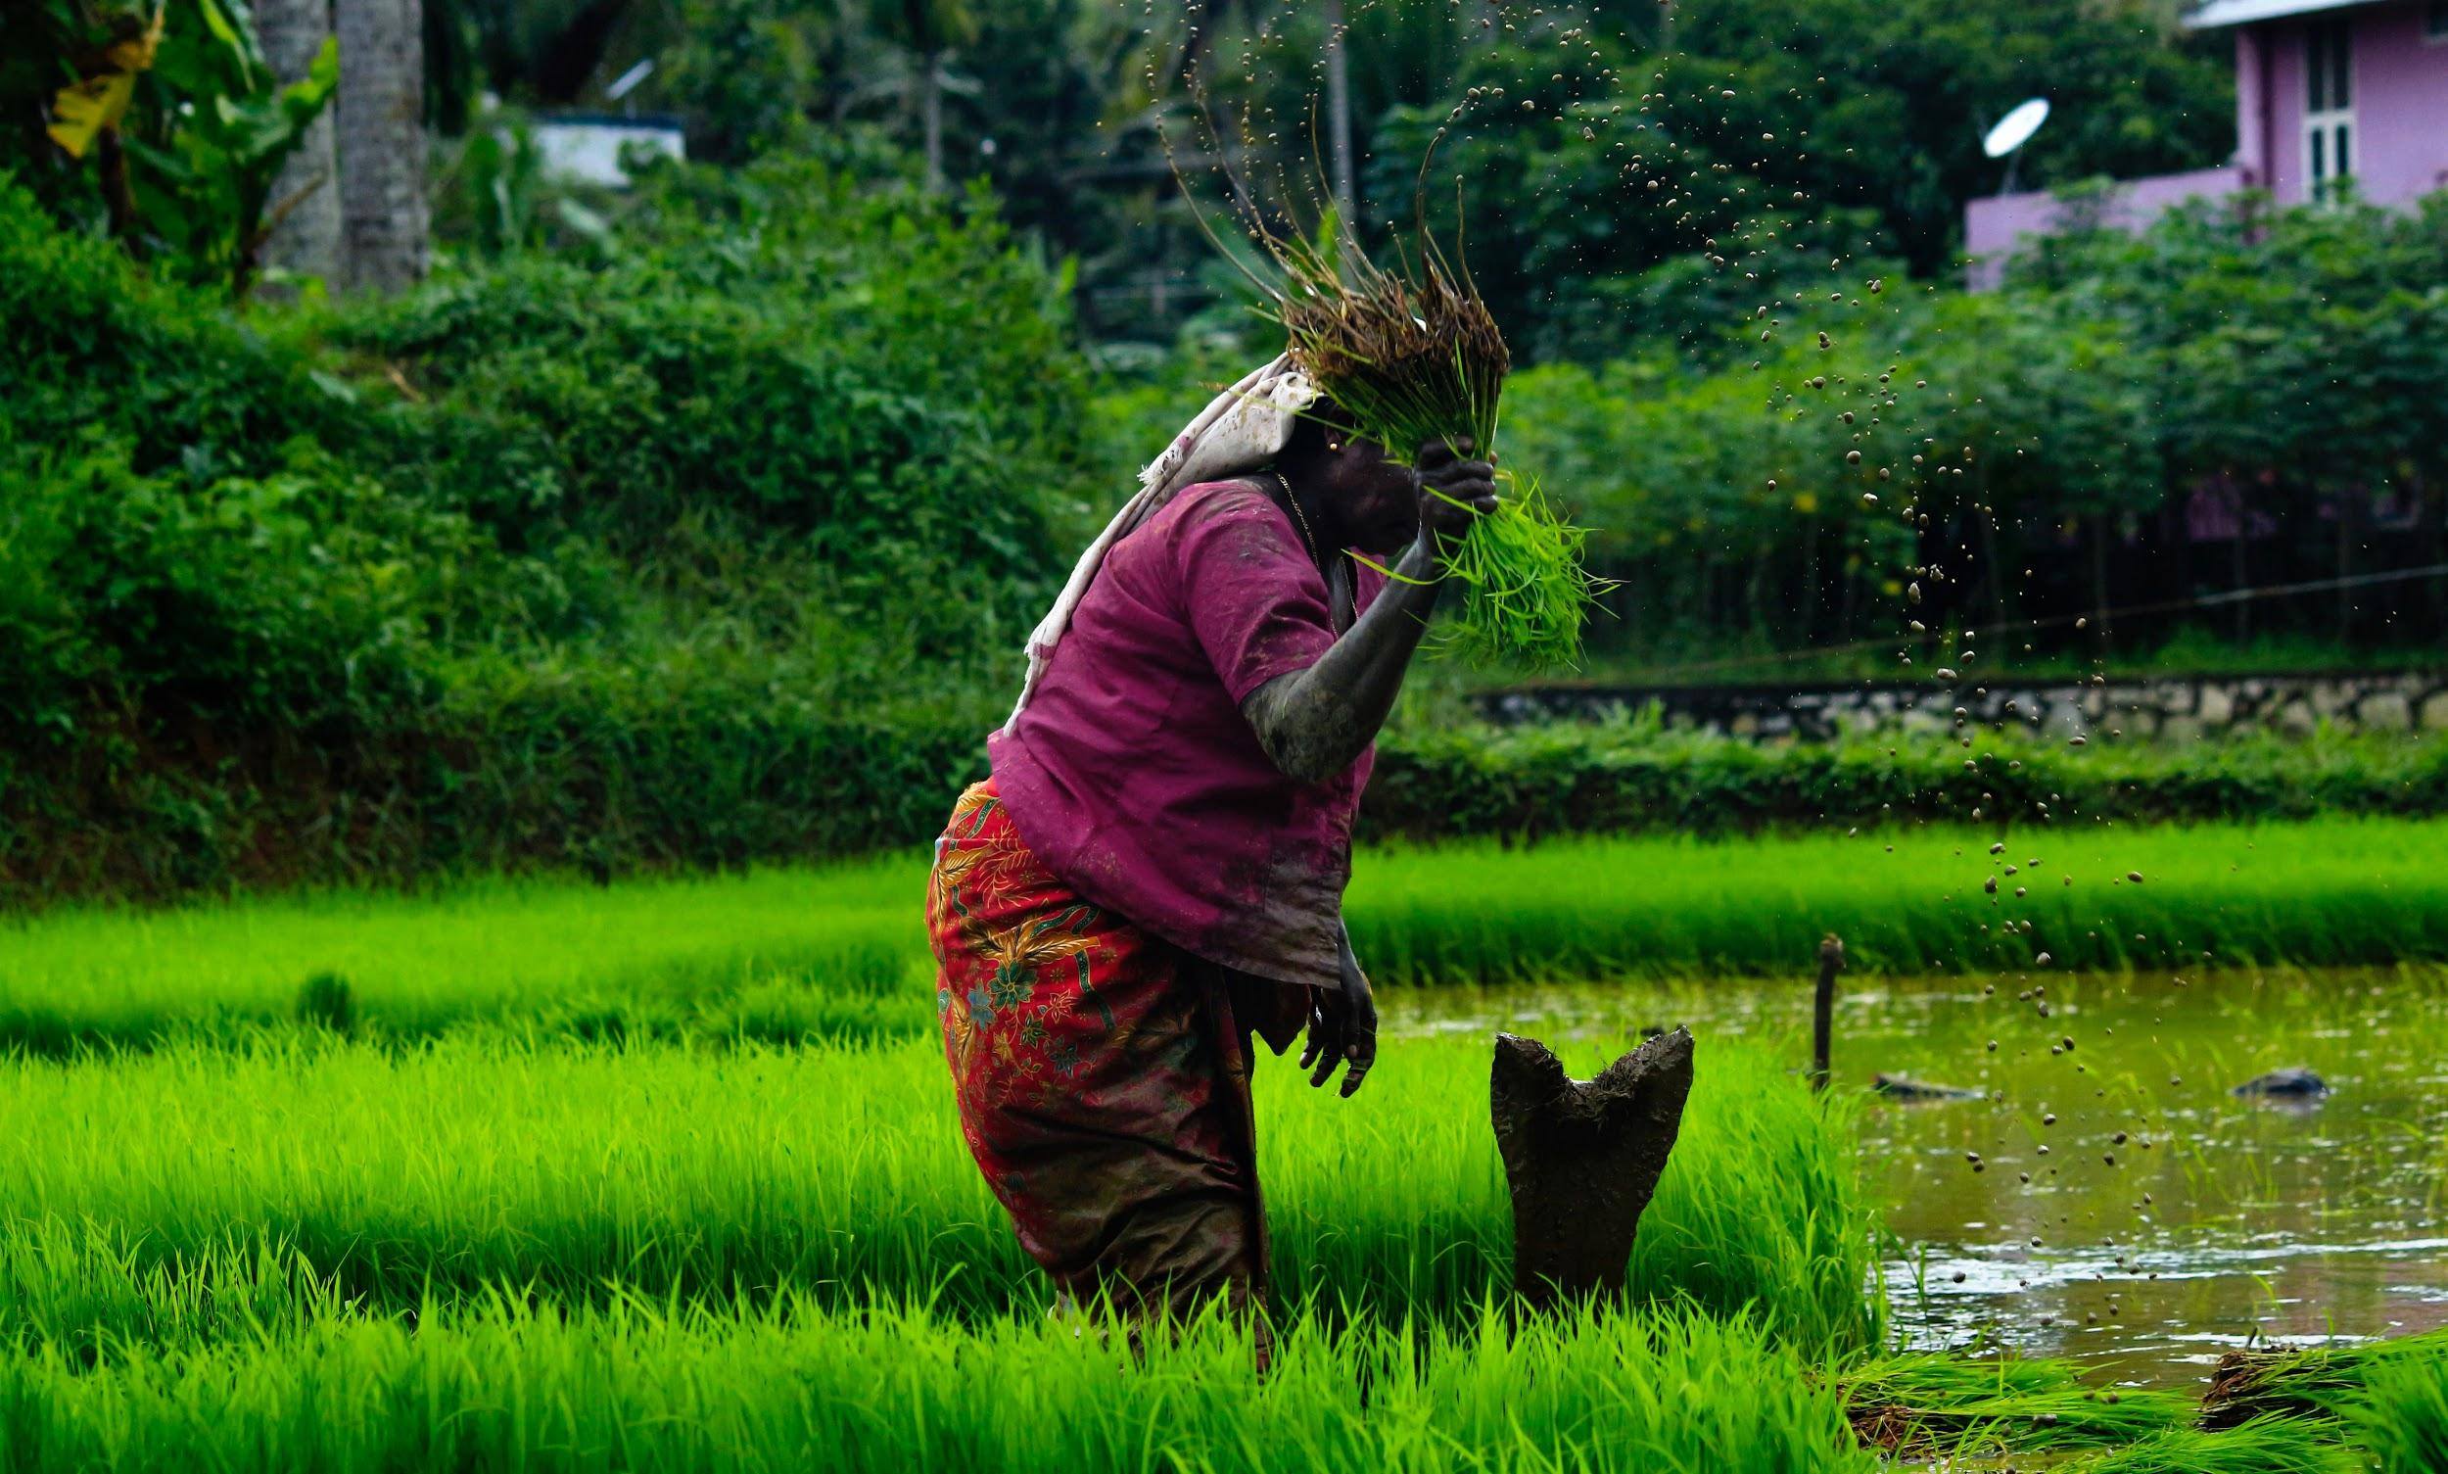
Current Alternatives: Middlemen
Middlemen has for long being a source of concern for farmers as they are being underpriced for goods they produce,since they can’t access the mainstream market either due to their remote location or inaccessibility to consumers.
Mr. Obi has harvested new organic produce from his plantation and he needs to sell them, he goes to the middleman (Wholesaler, retailer etc) to negotiate prices,after which they both agree on a price.
The wholesaler/retailer then sells to a consumer for double the amount he purchased from Mr. Obi leading to inconsistency and fluctuation in prices.
Mr. Obi goes home with less than his product worth, with this rate he wouldn’t be able to expand his business and purchase good nutrients needed for his organic farm.

Slide 12
Product Market Fit

Slide 13
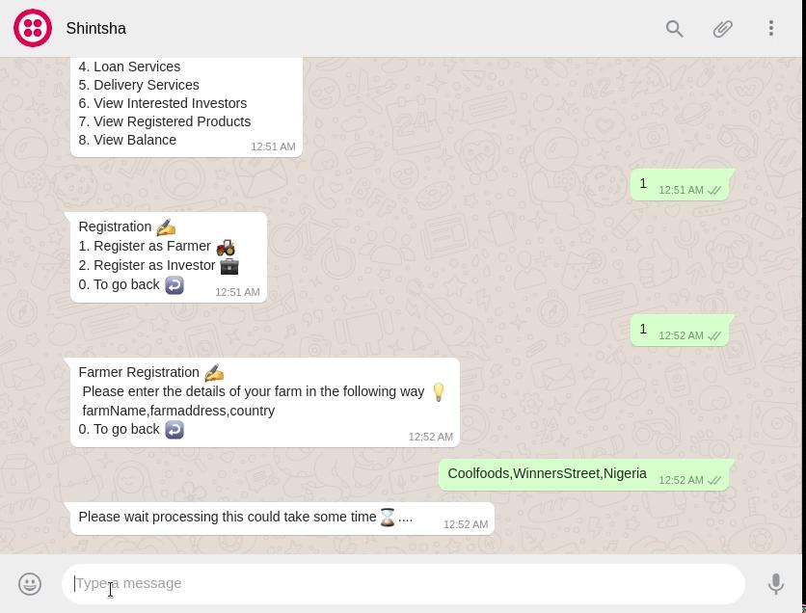
Product Demo :Farmer

Slide 14
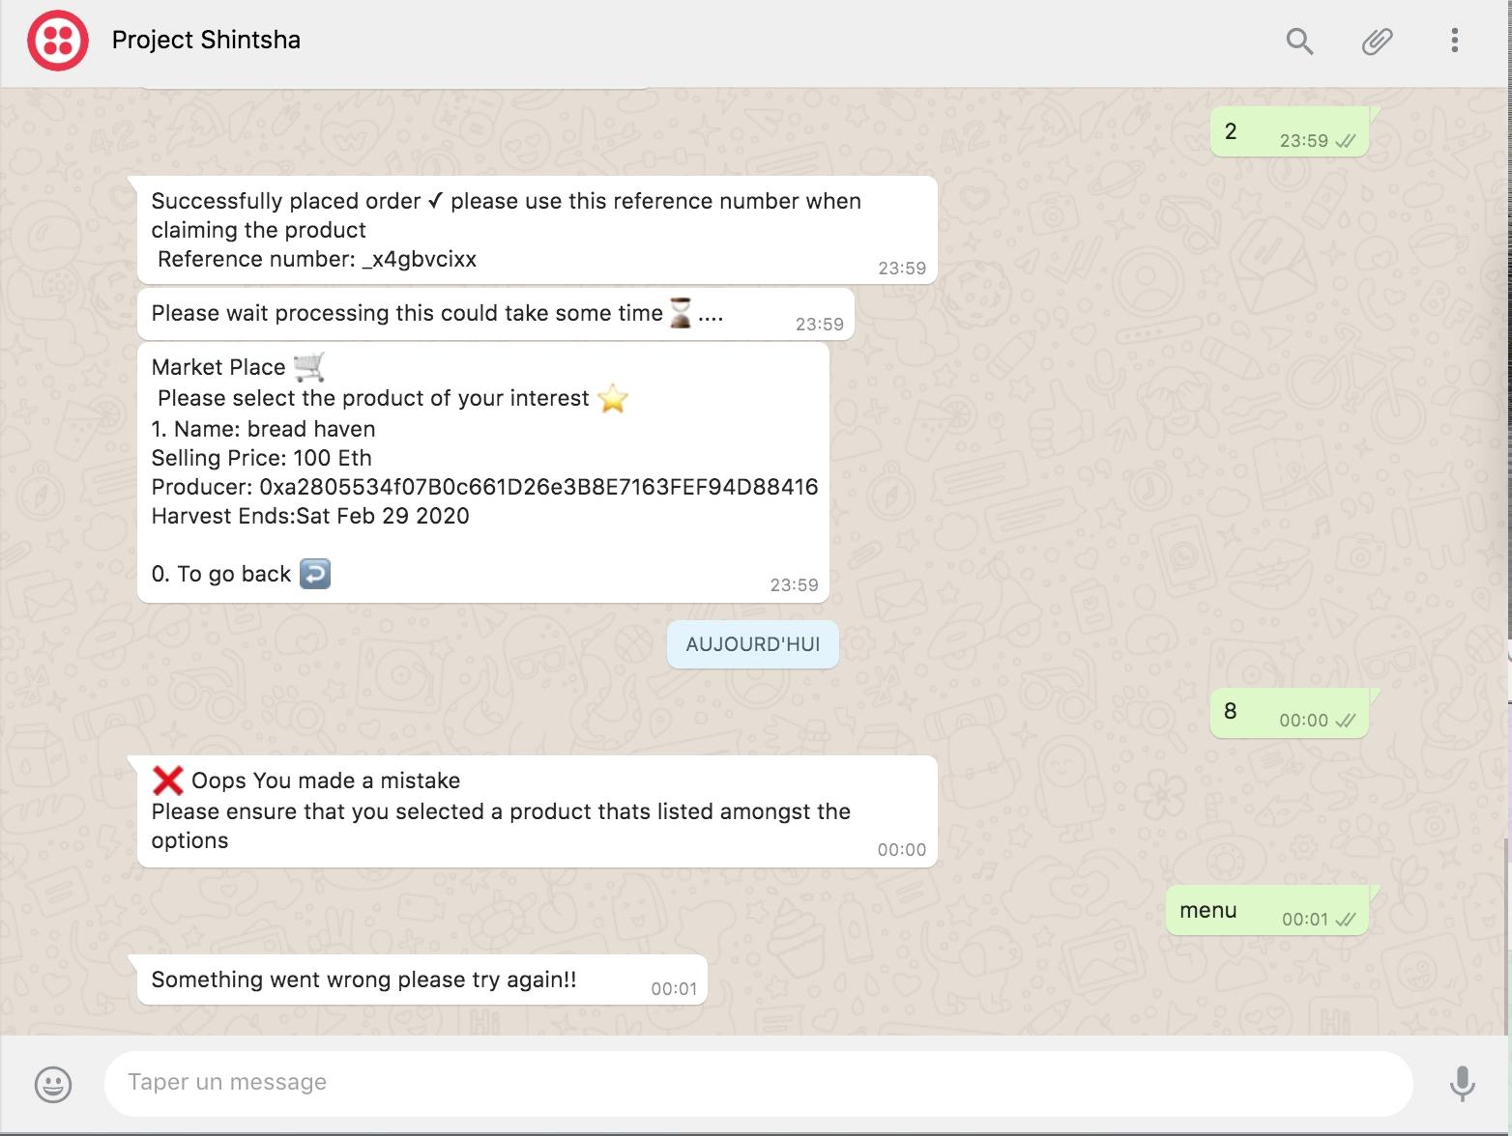
Product Demo : Investor/Buyer

Slide 15
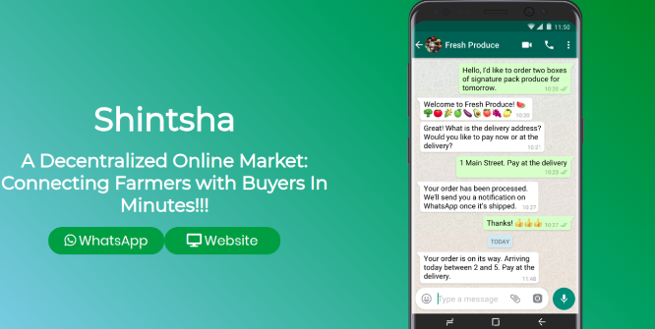
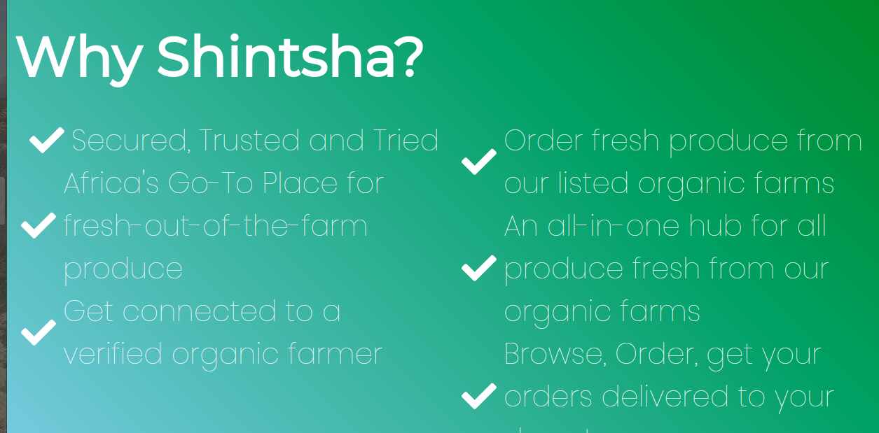
Prototype
We built a web3 prototype (Shintsha) focused on enabling a high-level user-friendly experience for buyers and organic farmers to connect, through web3 and through whatsapp.
This prototype is to demonstrate to potential SMEs how the Shintsha platform works and how Farmers can use it to connect with buyers.
The whatsapp no for Shintsha is: +1 415 523 8886, after which you can send a prompt: “join using-carried” to be added to the sandbox.

Slide 16
Prototype Details
LINKS
Web3 Demo: https://brianspha.github.io/Shinstha-Project/
Github: https://github.com/Brianspha/Shinstha-Project
LIMITATIONS
Track authenticity of farmers produce and their farms
Mr. Obi is a fictional use-case
Market price is not determined yet
FEATURE IMPLEMENTATION/ROADMAP
Connect with Verified Organic for authentication of farmers crops and farms.
Alternative sms prompt for farmers if internet is inaccessible, notification to buyers when ordered produce is available and ready for delivery.
International trade and delivery of goods to buyers/investors.
Access to soft loan implementation based on farmers documented reputation overtime.
Implement update of information on current market prices, eg prices of organic fertilizer, etc for farmers.
MAIN FEATURES
Shintsha smart contract will hold all information regarding Farmers, Farmer Products and buyers, Potential Investor. The contract will Inherit the ERC721 Full Token Contract.
Usage of Whatsapp by farmers for registration of their farms and products on Shintsha platform.
A web3 interface for buyers/investors to connect with farmers, and product listings.
Farmers can also accept payment in ETH/ERC20, and Fiat.
Delivery of goods and international payments.
Loan disbursement to farmers who have a reputation in kudos of upto 50 or NFTs of up to 100, this reputation is being given to the farmer by an investor or buyer who upvotes his profile after successful delivery of product.

Slide 17
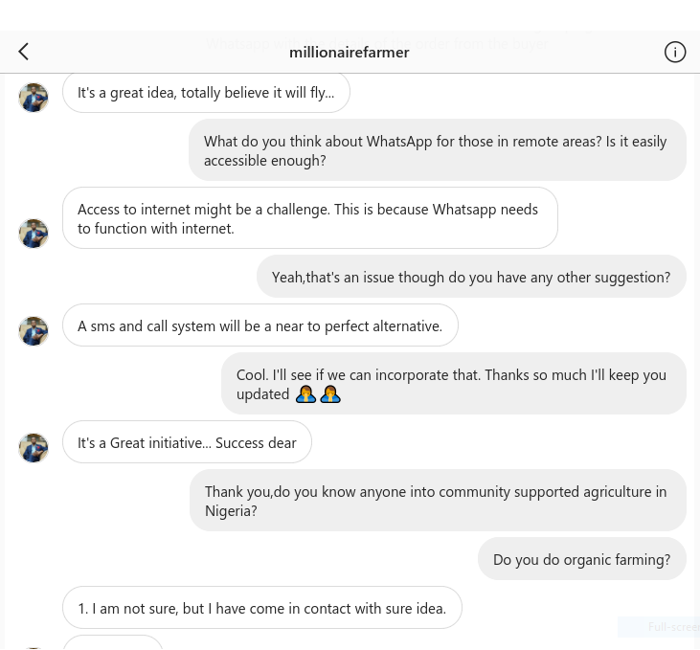
Industry Advisor 1
Hypothesis
Build a product using whatsapp API to enable farmers interact with their buyers/investors, farmer can save their details on Whatsapp,will be notified when buyers are interested, advertise their products on Shintsha via upload on whatsapp, which will be saved via smart contracts on the blockchain.
SME
We got in contact with Christian Okorode (CEO of Millionaire Farms, Nigeria) to validate the idea, he raised some concern regarding issues with internet in remote locations in Nigeria, and that an alternative could be to send an SMS prompt notifying the farmer to check their whatsapp messages from Shintsha, and also consented to trying out the app when it goes live.
Instagram handle: MillionaireFarmer

Slide 18

Industry Advisor 2
Hypothesis
Build a product using whatsapp API to enable organic farmers interact with CSA members, a farmer can register their farm and personal details on Whatsapp, and CSA members could also save their order, choose a farm, contribute to a pool system with other CSA members to fund the farmer all on SHINTSHA platform.
SME
We got in contact with Mouhamed Alassane Diallo and Ibrahima Diallo (CEOs of AGROGEN, Senegal) and validated the idea of remote organic farmers using whatsapp for their business because a vast majority has access to whatsapp-enabled phones, he also validated the CSA model and that it is very much welcomed in Senegal since they have a culture of supporting each other, he also said the CSA model is being practised in Senegal.
Instagram handle: AGROGEN
Voice recording from Mouhamed and Ibrahima Diallo
NB: Please listen to audio via google slides or powerpoint.

Slide 19
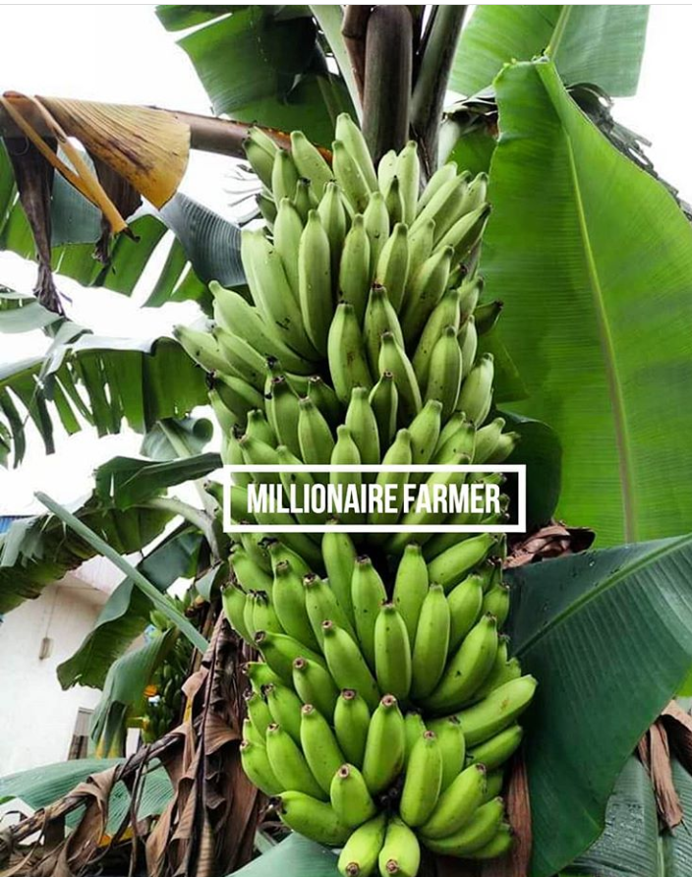

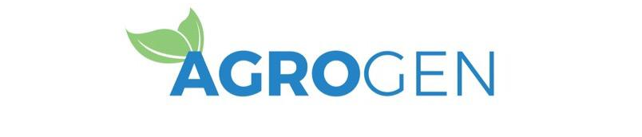
Industry Focus
Industry: Community Supported Agriculture (CSA)
CSAs are partnerships of mutual commitment between a farm and a community of supporters that provide a direct link between the production and consumption of food. Supporters usually cover a farm’s yearly operating budget by purchasing a share of the season’s harvest and in some cases they assist with the farm work. In return, the farm provides, to the best of its ability, a healthy supply of seasonal fresh produce.
Target: Organic Farmers
Granting owners of organic farms access to manage their finances and maintain contact with their CSA customers directly through the web 3.0, also organic farming is much needed because it fosters preservation of the environment.
Potential Early-Adopters:
Farmers
SMEs
Buyers/Investors

Slide 20
Why Blockchain?
The benefits of openness extend to all honest market participants. Blockchain technologies can prevent price extortion and delayed payments while simultaneously eliminating middlemen and lowering transaction fees. This can lead to fairer pricing and even help small-holder farmers capture a larger part of their crop value.
Blockchain promises to improve traceability and transparency within agriculture value chains. The ability to quickly trace the origin of food products would be an invaluable tool during contamination incidents. With blockchains, regulators can quickly identify the source of the contaminant and determine the scope of affected products. A more timely response by food companies can prevent illness, limit food waste, and contain financial fallout.
Blockchain technology could securely record information and trace products right from the small-scale farm all the way to consumers’ forks. This would not only satisfy consumers’ demand for provenance but allow farmers to build their reputations and charge more fair prices by comparing to similar transactions.

Slide 21
Potential: The Decentralized Shintsha Farmer
The impact of mobile phones continues to be felt beyond the telecom sector as innovation to solve day to day problems are developed particularly for the agricultural sector. The penetration of mobile phones in Africa is currently at 44% according to the latest statistics from GSMA. The successful uptake of mobile phone by farmers in countries such as Nigeria and throughout Kenya has led to mobile innovations around some of the main challenges that farmers face: access to information, markets, and capital. The agricultural market in Africa is projected to grow to $1 Trillion by 2030. The sector is, however, an unsystematic and complex value chain that presents challenges in keeping and maintaining a database of all stakeholders; farmers, insurance companies, financial service providers, development partners and, governments. The use of blockchain technology has proved via transparency and immutability it’s capability in disrupting various sectors in Africa especially agriculture.
Source: Cellulant
INCENTIVES TO USE SHINTSHA
Secure, trusted and reliable
Easy access to buyers and investors by farmers.
Shared risk when using the CSA model.
Access to soft loans based on built reputation overtime.
Valuable exchange (trade between international markets and currencies both in eth/erc20 and fiat).
Low cost of transaction on the Shintsha platform.

Slide 22
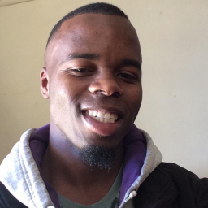


The Team
Brian Siphamandla
Owanate Amachree
Badara Diakhate
Blockchain Developer
Backend Developer and Technical Writer
Blockchain Developer

Slide 23
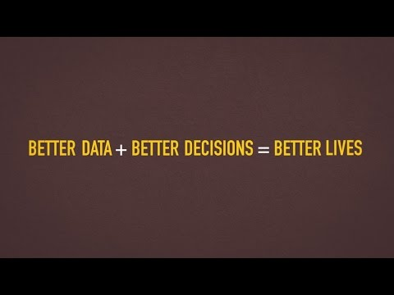
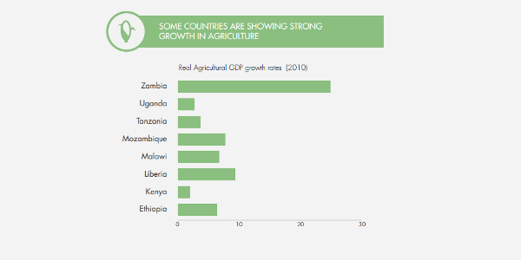
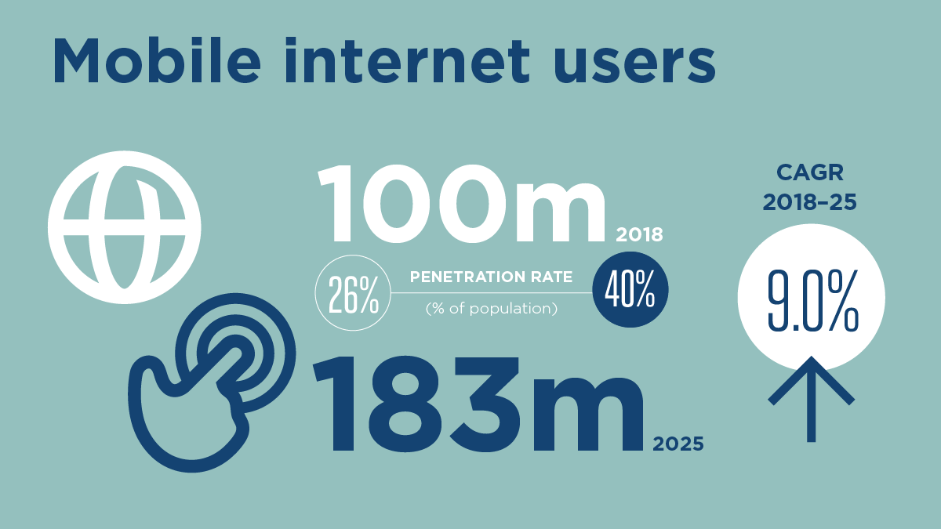
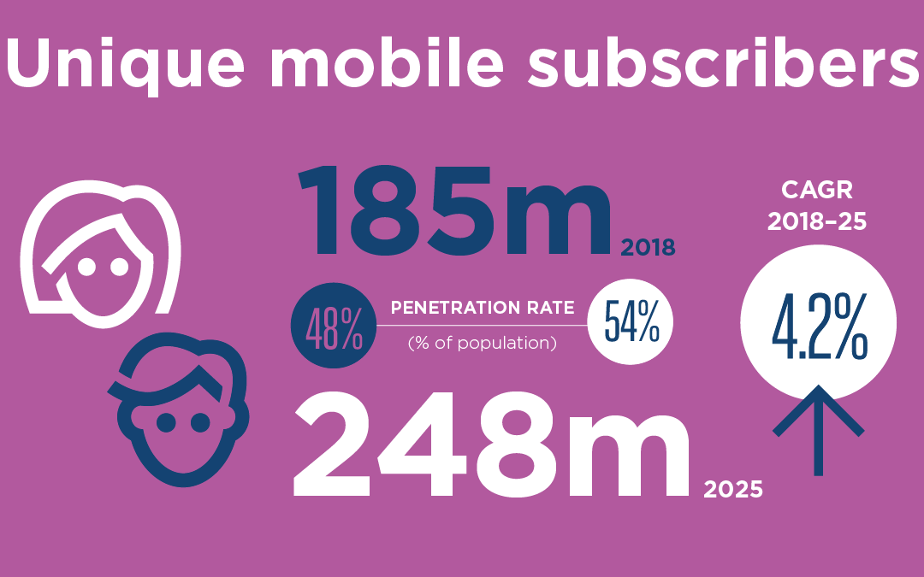
Attachment

Slide 24
Sources
https://www.cellulant.com/blog/blockchain-techology-in-africa/
https://play.google.com/store/apps/details?id=com.agromarketday&hl=en
http://www.agromarketday.com/
http://www.fao.org/e-agriculture/blog/how-blockchain-can-help-smallholder-farmers
http://www.agriledger.io/
https://www.ifoam.bio/en/community-supported-agriculture-csa
https://www.integrated-cbd.com/our-farms
https://www.verifiedorganic.io/
https://www.gsma.com/r/mobileeconomy/west-africa/
https://www.worldbank.org/en/news/video/2015/06/11/telling-myths-from-facts-africas-agricultural-data-gap
https://www.howwemadeitinafrica.com/agriculture-africa-potential-versus-reality/57635/
https://gro-intelligence.com/insights/articles/blockchain-in-agriculture

